Slide 1
Ultra-thin Electronic Skin
for Real-Time Health Monitoring
Client & Adviser: Dr. Liang Dong
Iowa State University
Spring 2019 - Senior Design Team 20
Justin Gordon, Omar ElSherbiny, Sangwon Lee, Sovann Chak, Sungmin Kang

Slide 2
Problem Statement
 | Problem Statement
Lack of options considering real-time health monitoring
Current technology is rather bulky and uncomfortable
Not very accessible outside of medical institutions
sddec-19-20
Notes:
3 glaring issues:
Lack of options
Smart watches do not provide enough data and can be inaccurate
Technology that provides accurate and useful information less accessible for people also dealing with hospital costs
Current technology is bulky and uncomfortable
Inconvenient to use
Multiple electrodes
Large machine system
Not very accessible
Commercially available machines
Expensive
May need training to know how to use/help of a medical professional
Compact visuals may confuse users

Slide 3
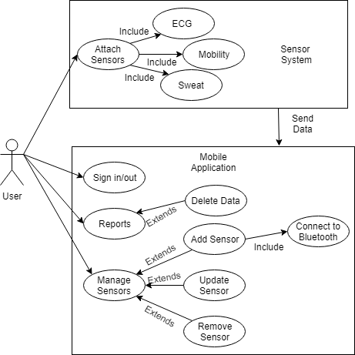
Conceptual Sketch
 | Conceptual Sketch
Use case
2 Systems:
Sensor System
ECG Sensor
Mobility Sensor (Accelerometer)
Sweat Sensor
Mobile System
Data Collection
Data Reports
Sensor Management
Data Visualization
sddec-19-20
Notes:
Sensors will be attached to respective areas:
ECG will be placed above the left breast of patient
Mobility sensor will be placed on the elbow and/or knee of the patient
Sweat sensor will be placed under the armpit of the patient
Each sensor will use bluetooth to send data to the mobile device
Mobile System
Collect the data through bluetooth
Create graphs for the data readings received
Craft reports of the data gathered
As well as manage paitent sensors

Slide 4
Potential Risks
 | Potential Risks
Circuit and Prototype Construction
Soldering
Testing and use of wearable
Live electrical current
Fabrication Techniques
Hazardous chemicals
Data Security
Secure handling of user data
sddec-19-20
Notes:
Physical Risks including
Soldering
Goggles
Gloves
Long clothing
Clean workspace
Testing and use of wearable
Learn and practice safety regulation regarding live currents
Fabrication
Hazardous chemicals
Data security
Handling sensitive data by saving it locally

Slide 5
Resource and Cost Estimates
 | Resource and Cost Estimates
Ultra-Thin Wearable
Materials
Printer
Lab personnel
Biological Signal Analysis Algorithms
Heartbeat
Sweat
sddec-19-20
Notes:
Resources needed for our project include:
Wearable
Materials used in the creation of a comfortable ultra-thin wearable
3D printer and a process used to create the needed circuits of the wearable
Algorithms
The three sensors that are going to be produced are going to each need an algorithm in order to make the data human readable

Slide 6
Project Milestones and Schedule
 | Project Milestones
Ultra-Thin Wearable
Finalized circuit designs
Functioning sensors
Data communication
Mobile Application
Working Prototype
Testable endpoints that communicate with each sensor
sddec-19-20
Notes:
Wearable
Circuit designs are created and a detailed process is documented for future use
Sensors are functioning properly and readings are consistent
Mobile application is able to receive data from each sensor
Mobile application
Prototype created to simulate the communication between the application and the sensors is completed and used to further work on the application
Easy to use endpoints to connect with the final product and finish dealing with the discrepancies between the prototype and product

Slide 7
Mobile Application - Requirements
 | Mobile Application - Requirements
Functional
Read heartbeat
Detect falls
Analyze sweat
Non-Functional
Securely handle data
Communicate with patch wirelessly
Minimal delay
sddec-19-20

Slide 8
Technical Constraints / Limitations
 | Technical Constraints / Limitations
Economic factors
$500 maximum
Size of the ultra-thin wearable
Limits hardware options
Temporary
Necessity for prototype
Develop mobile application concurrently
Test software
sddec-19-20
Notes:
Economic
Limit the scope of our prototype
Glucose sensor +$100
Size of the ultra-thin patch
Limits the purchasing of products
Ultra small communication/bluetooth chips can be very expensive for a devices which is temporary
Necessity for prototype
In order to work in parallel with the hardware team - we need a way to test our mobile application
The readings between our prototype and the actual patch could have drastic differences
More focused nature of the wearable

Slide 9
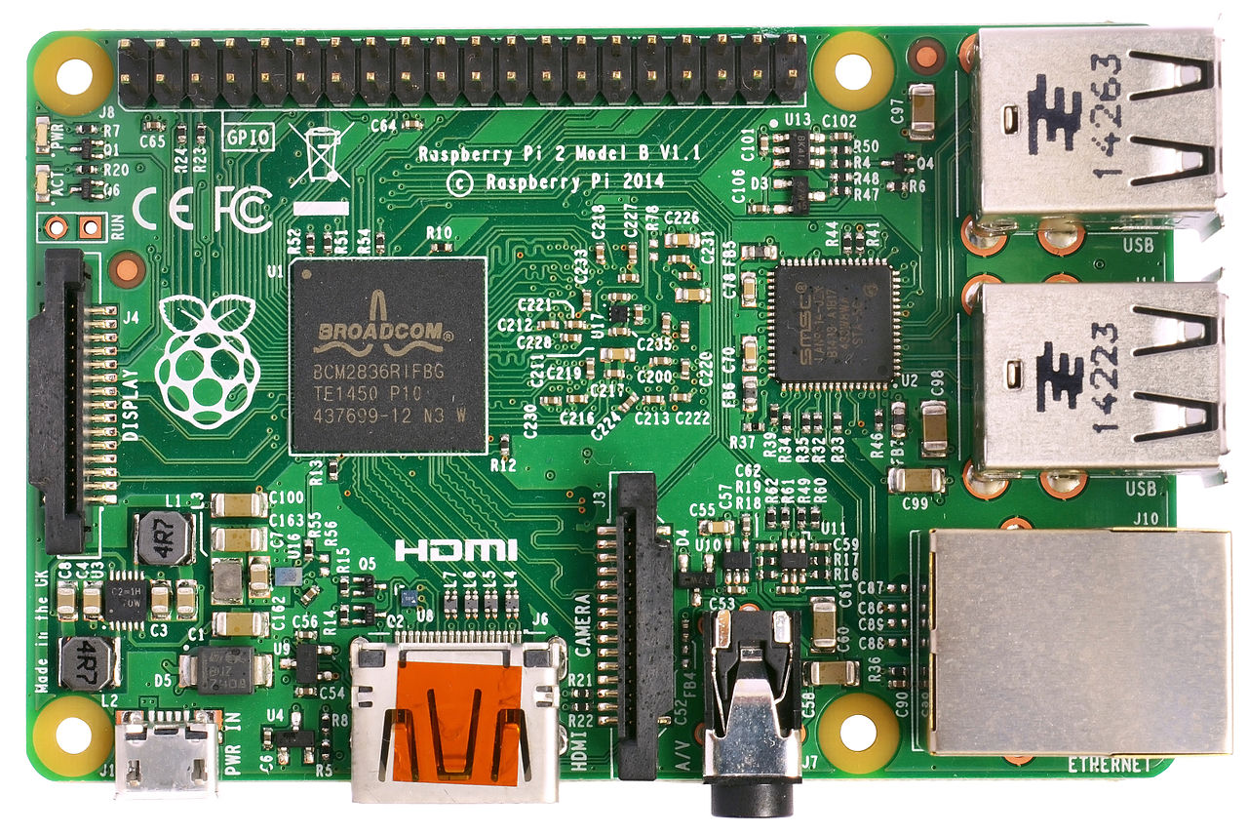
Prototype
 | Prototype
Raspberry Pi 3
Built in bluetooth
Easily to modify and connect sensors
External Boards
ECG Sensor
Accelerometer sensor
sddec-19-20
Notes:
We need the prototype to create our application in parallel with the hardware team
Raspberry Pi 3
Easy to set up and quickly prototype
A lot of sensor circuits to choose from
…
ECG/Accelerometer sensor hooks up to the Raspberry pi 3 and data will be caught via bluetooth

Slide 10
Software/Technology Platforms
 | Software/Technology Platforms
Xcode 10.1
Built in
Test iOS device
Drag and drop
Swift
Extensive Frameworks
GCD
Bluetooth
…
Made for Apple products
sddec-19-20

Slide 11
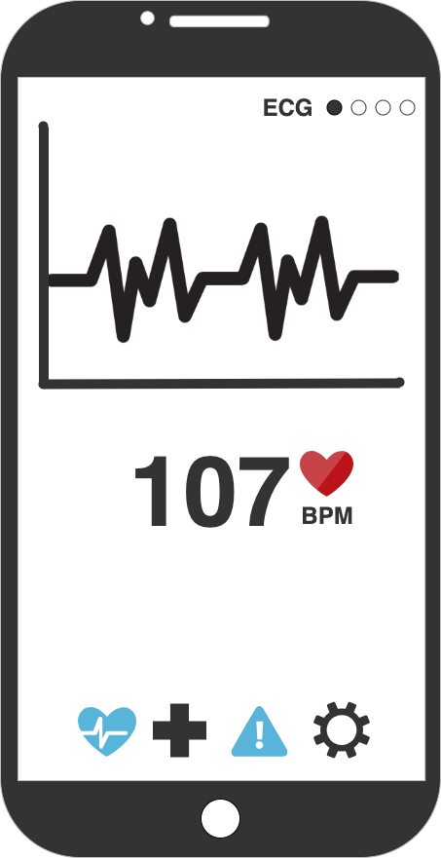
Design
 | Design
Raspberry Pi 3
Each sensor has a corresponding page
Simplicity is the goal
MVC Architecture
sddec-19-20

Slide 12
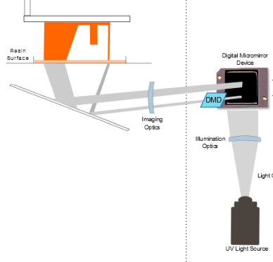
 | Fabrication technique
Digital Micromirror Device(DMD)
A programmable array of millions of micromirrors that could take the shape of the desired circuit
Light is illuminated on the DMD and the reflected image hits a resin surface that hardens upon exposure
Optical challenges arise
Requires a lot of research to be implemented
sddec-19-20
Notes:
Available DMD only works with visible light. UV light is preferable for precision
Optical lenses are needed to focus the light beams and eliminate aberration and astigmatism
Optical lenses are expensive ~$120

Slide 13
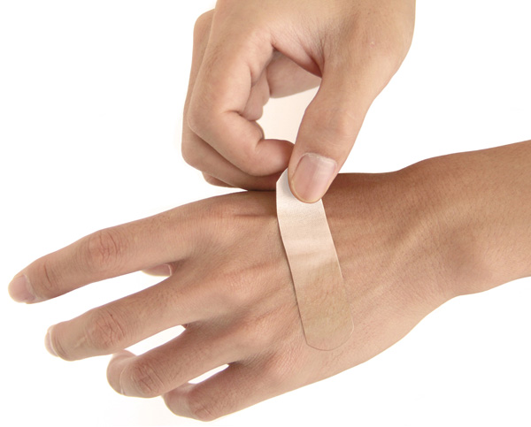
 | Sweat Sensor
Characteristics
Human sweat contains different types of ions, and compounds
Ion levels could indicate of hydration, electrolyte imbalance, and heat-stress
The goal is to develop a Band-Aid like sensor in a low-cost manufacturing process.
sddec-19-20

Slide 14
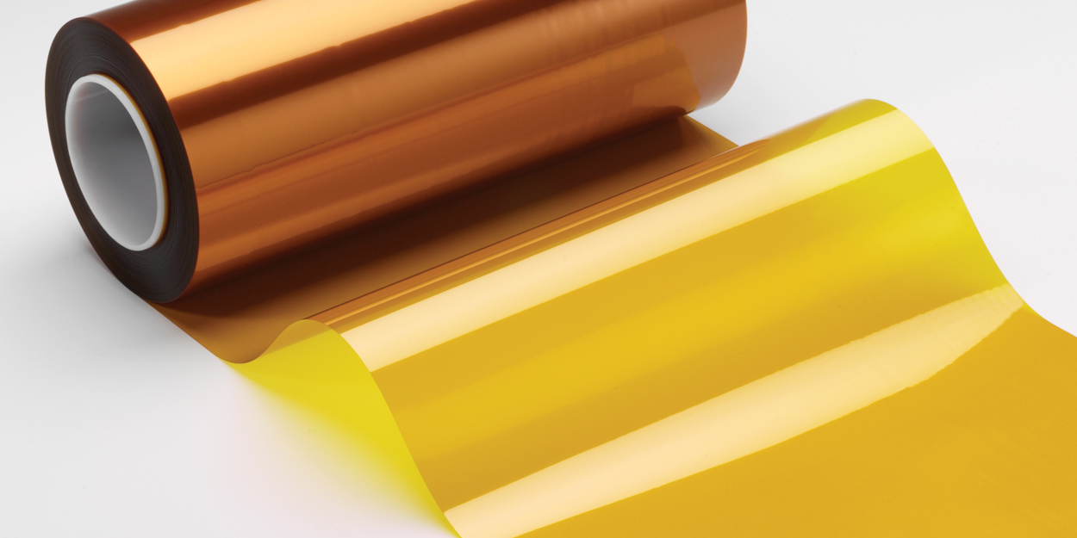
 | Sweat Sensor- Fabrication
Use DMD if we can get help putting the 3D printer together
Use graphene or PDMS
Use Dupont Pyralux sheet. Combination of copper and kapton
sddec-19-20

Slide 15
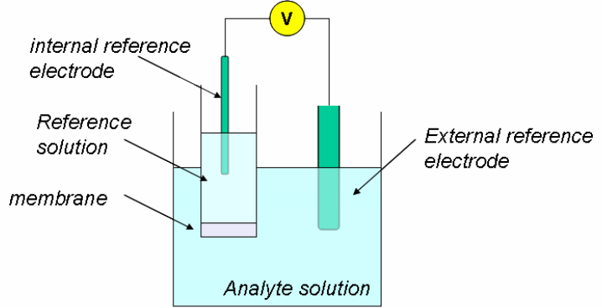
 | Sweat Sensor- Sensing Electrodes
Design an ion-sensing electrode to detect desired ions.
Ionophore (ion-selective)membrane is to be chosen to attract desired ions
Potential difference between reference electrode and working electrode will be correlated to concentration of said ion
Research needed to know what kind of plating is needed on each electrode, and membrane identity to determine selectivity of elecrode
sddec-19-20

Slide 16
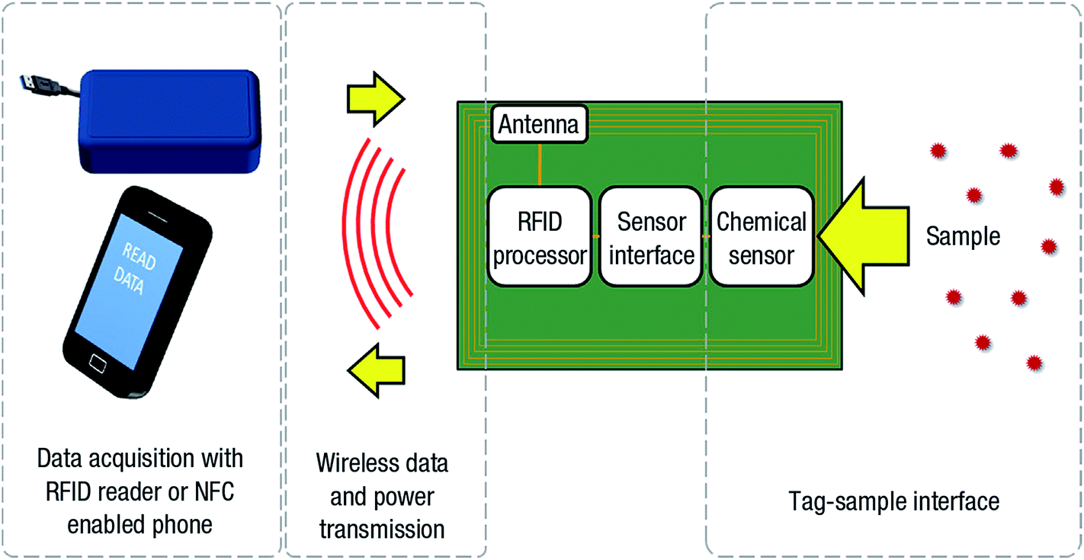
 | Sweat Sensor- Communication
The sensor should be able to communicate with the application
RFID is what we are currently considering
Bluetooth is also an option but presents power challenges
RFID requires an antenna and antenna tuning
Consult Dr. Nathan Neihart or Dr. Jiming Song
sddec-19-20

Slide 17
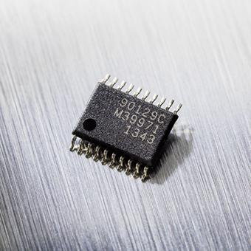
 | Sweat Sensor
Ideally the sensor will communicate with the application using NFC RFID protocols
Use a small RFID transponder chip.
There is a plethora of commercial options, but the option we will consider first is the Melexsis MLX90129
Used in published literature
Requires significant programming to be used as a sensor
sddec-19-20

Slide 18
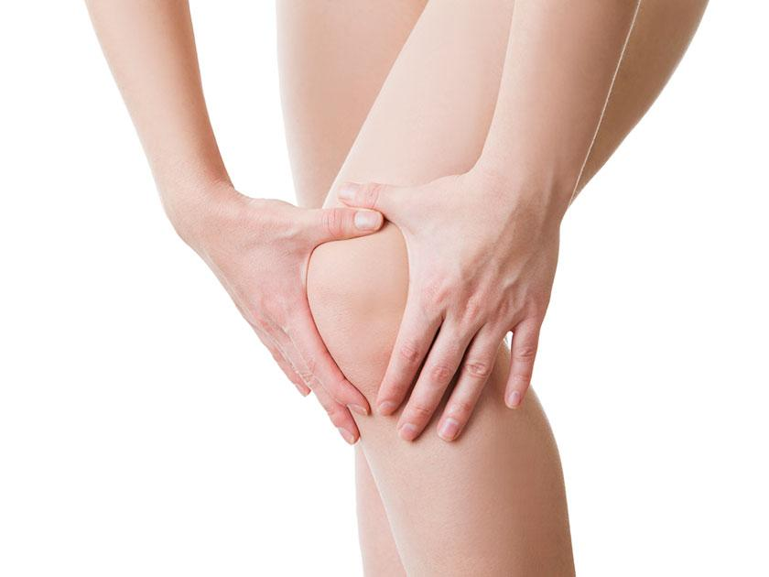
 | Mobility Sensor
Problem statement & Conceptual sketch
Measuring resistivity by bending knee
Put string-shaped sensors on the knee
Mobility Sensor
https://www.womansweekly.com/health/what-is-causing-your-knee-joint-pain-19670/
sddec-19-20

Slide 19
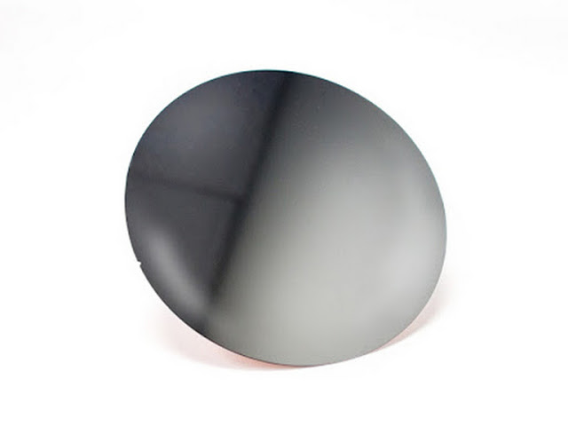
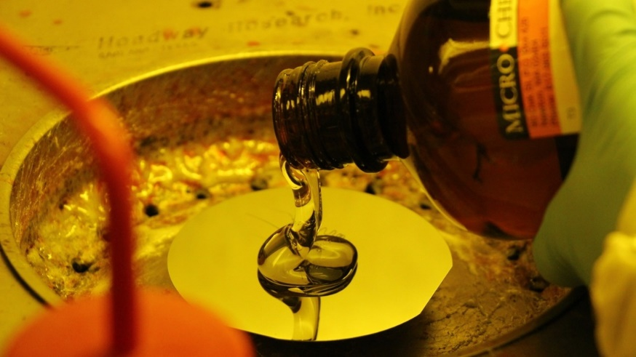
 | Mobility Sensor - Fabrication
Pattern Fabrication Steps
Silicon wafer
Su-8 <- For photo-resistive (1 ml)
https://www.matterhackers.com/store/printer-accessories/silicon-wafer-print-bed-plate-200mm
https://geckogloves.weebly.com/basic-micro-hair-developing-method.html
sddec-19-20

Slide 20
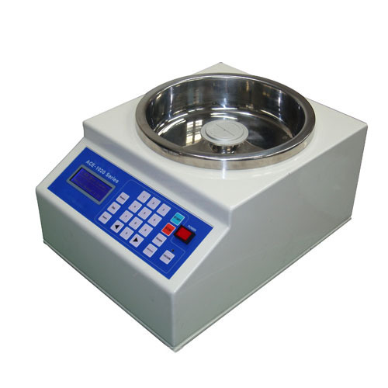
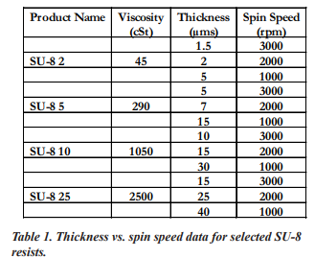
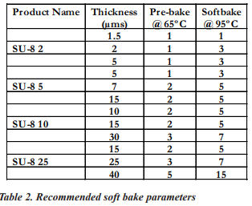
 | Mobility Sensor - Fabrication
Pattern Fabrication Steps
Spin Coater by thickness
(500 rpm for 5 seconds, 900 rpm for 20 seconds)
After soft-baking SU-8, put photo mask
http://www.microchem.com/pdf/SU8_2-25.pdf
http://www.microchem.com/pdf/SU8_2-25.pdf
sddec-19-20

Slide 21
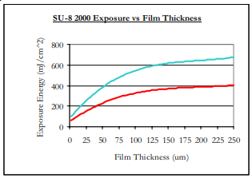
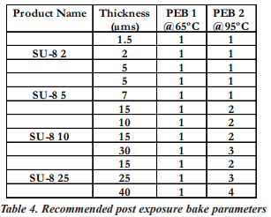
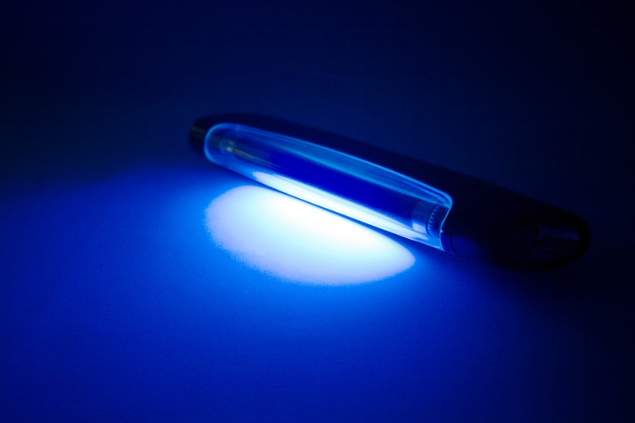
 | Mobility Sensor - Fabrication
Pattern Fabrication Steps
UV-light and Post-bake
Put SU-8 developer
Try isopropyl alcohol on the edge
Clean with water and acetone
http://www.microchem.com/pdf/SU8_2-25.pdf
https://www.sciencefriday.com/segments/how-uv-light-could-zap-the-flu-bug/
sddec-19-20

Slide 22
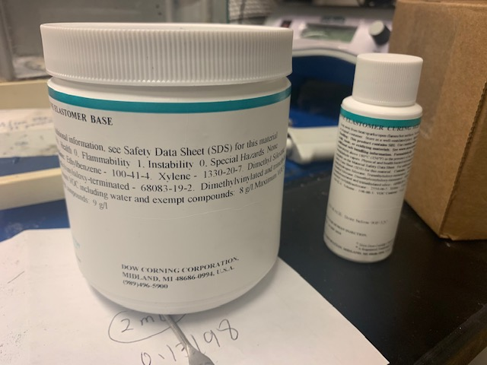
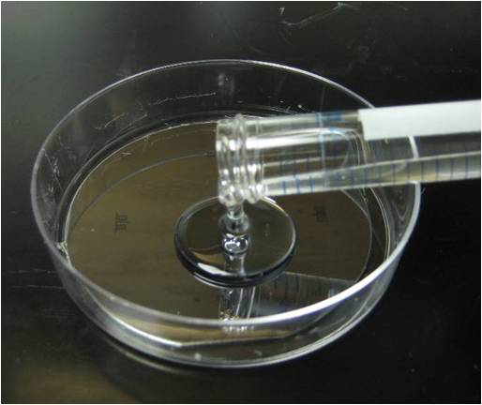
 | Mobility Sensor - Fabrication
Making PDMS Molds
After getting positive pattern, prepare PDMS.
Mixing it with 10:1 ratio, and degassed for removing bubble
Then, pour it on the wafer gently.
sddec-19-20

Slide 23
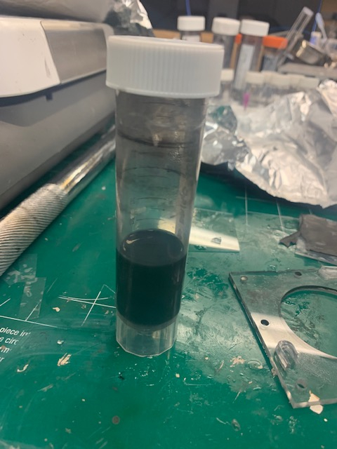
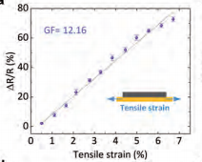
 | Mobility Sensor - Material
Flexible and Stretchable Material
Graphene
Covalently Bonded to 3, so Fourth Atom is Free
Large Intrinsic Mobility
(200,000cm2 V-1 s-1)
20mg Graphene + 700nl Water + 300nl Ethanol -> Sonication for 200 minutes
https://www.graphenea.com/pages/graphene
http://www.memslab.net/uploads/1/1/5/5/11554938/73_reduced_resolution.pdf
sddec-19-20

Slide 24
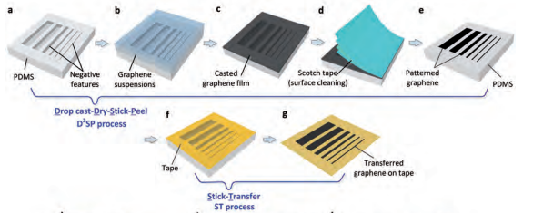
 | Mobility Sensor - Patterning Process
Graphene patterning Process
After getting PDMS mold, put graphene on the mold
Then, remove graphene using scotch tape except for our pattern
http://www.memslab.net/uploads/1/1/5/5/11554938/73_reduced_resolution.pdf
sddec-19-20

Slide 25
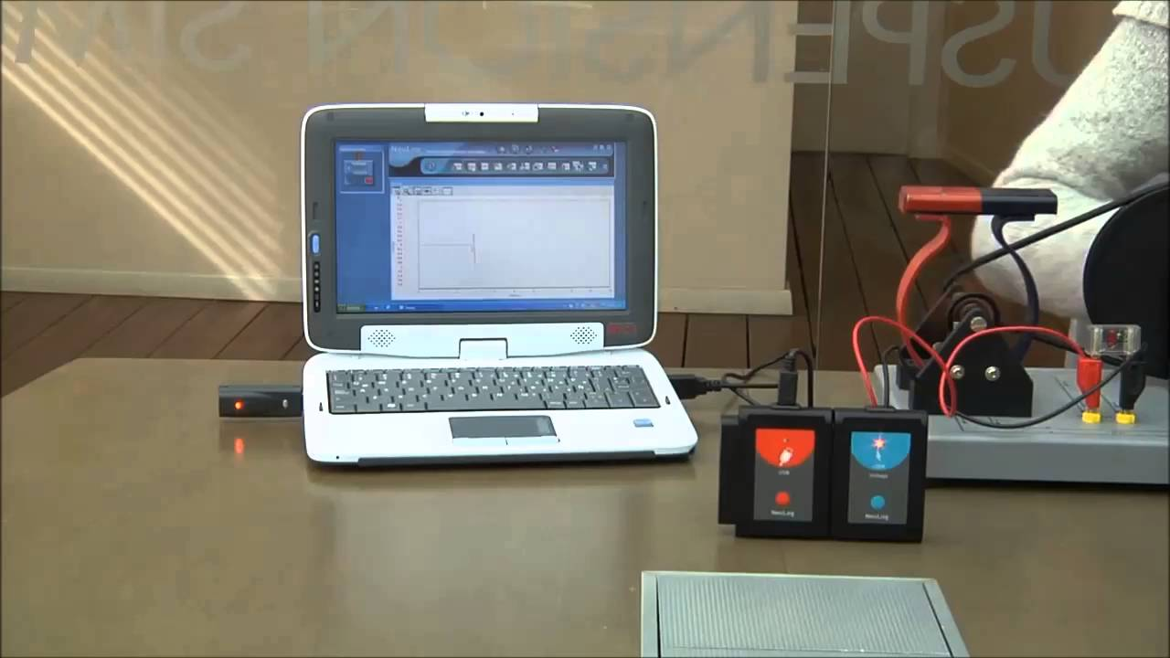
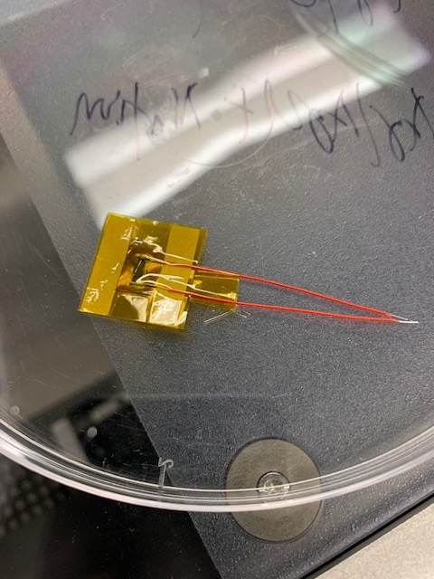
 | Mobility Sensor - Measuring Process
Read data from Mobility Sensor
Sensor Connecting
Ag/AgCl at each side for connection
Make led out
Cover with substrate
Data analysing
Using Neulog
Using Bluetooth function in Neulog
Monitoring the result on the portable device
https://www.youtube.com/watch?v=Kfef0hU-DFU
Ag/AgCl
Ag/AgCl
sddec-19-20

Slide 26
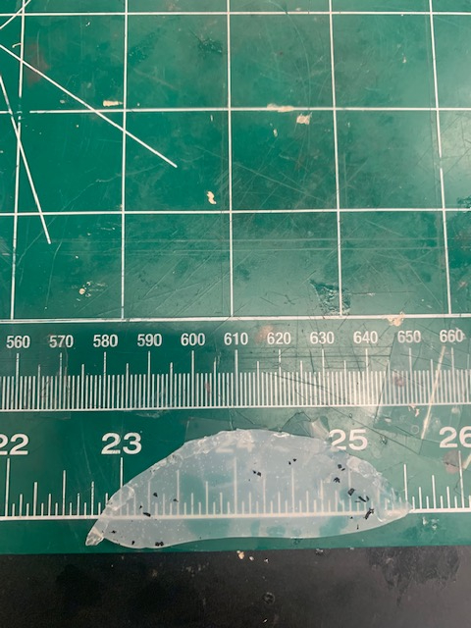
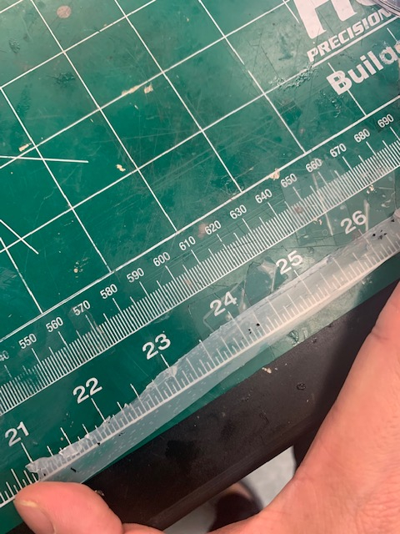
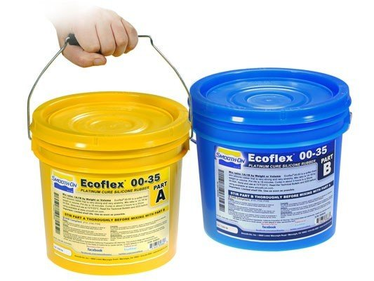
 | Limitation
Limitation
Our substrate (Polyimide tape) is not that stretchable
How to solve it
Replace with eco-flex
It is very stretchable substrate (at least 200%)
https://shop.sculpt.com/smooth-on-ecoflex-00-35-2-gallon-kit.html
sddec-19-20

Slide 27
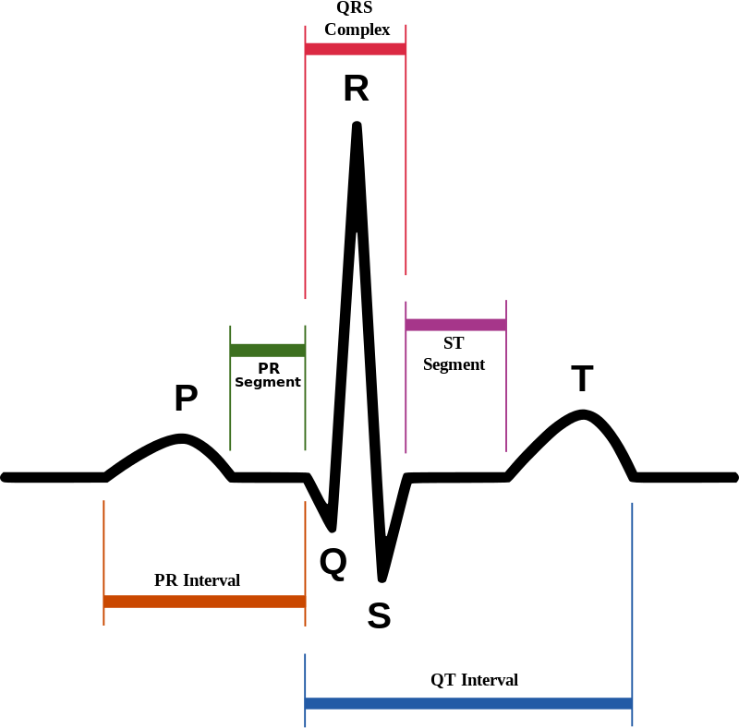
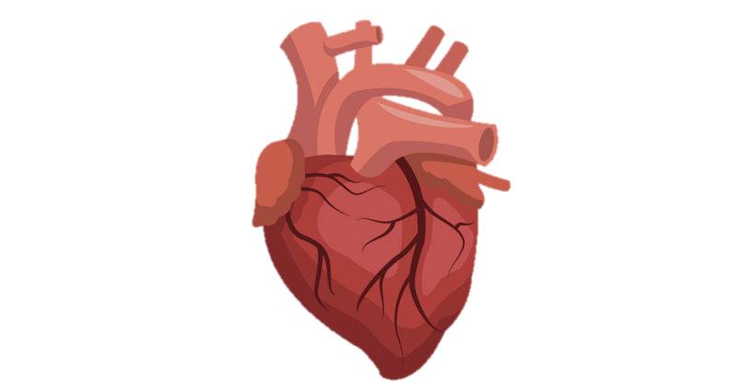
 | ECG Sensor processing steps
ECG – Processing Steps
Patient/User
Signals
Processing
Decision
67 BPM
sddec-19-20

Slide 28
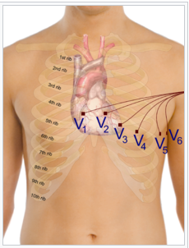
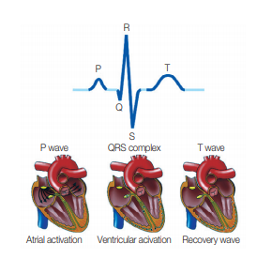
 | ECG- Electrocardiography
ECG - measures the electrical activity of the heartbeat
Characteristics
1mV range
1 ~ 200Hz
Voltage
(Sodium)Na / K between Cell membrane -60mV ~ 40mV
Electrical Stimulation from SA node
Ground(reference voltage) on Right ankle (Far from Heart)
Up to 12 leads model
1 Ground lead
Voltage difference between two lead
sddec-19-20
Notes:
2 ventricles and
2 Atrium
Electrical Stimulation from SA node to AV node His bundle, Bundle Branch and Purkinje fiber
QRS: depolarization of ventricles

Slide 29
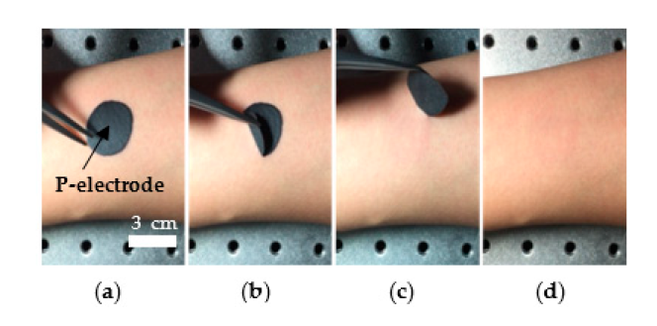
 | ECG – Graphite mixture electrode
Graphite mixture Electrode (P- Electrode)
Components
Graphite powder 30%
Polyvinyl Alcohol (PVA) 8%
Water 50%
Ethanol 8.5%
Butylene glycol 3.5%
Characteristics
165 Ohms /Square on average (10 different samples)
Easy to remove and attach
Reason for not using normal electrode
Ag/AgCl electrodes are not suitable for wearable healthcare devices
which are intended for long-term continuous monitoring
ECG Monitoring Garment Using Conductive Carbon Paste for Reduced Motion Artifacts
sddec-19-20
Notes:
The C-paste consists of graphite powder (150–200 mesh, Duksan, Ansan, Korea), polyvinyl
alcohol (PVA), water, ethanol, and butylene glycol. PVA is used as a film former, making it easy to
peel off the P-electrode from the skin. Ethanol is used to quickly dry the paste-like carbon electrode
after its application on the skin. Graphite powder composed of fine carbon particles gives the Pelectrode
its good conductivity. The graphite powder is not toxic, but ultrafine carbon nanoparticles
may cause unexpected harmful effects if they penetrate the skin. Therefore, we use graphite powder
with particles that are 74–90 μm in size, larger than the average size of human skin pores, 47 μm [36].
The graphite powder (30 wt %), H2O (50 wt %) and butylene glycol (3.5 wt %) are mixed and
dispersed by magnetic stirring for 1 h at 80 °C. Then, the PVA (8 wt %) and ethanol (8.5 wt %) mixture
solution is added to the pre-dispersed solution and dispersed again by a magnetic stirrer for 1 h at 150 °C.

Slide 30
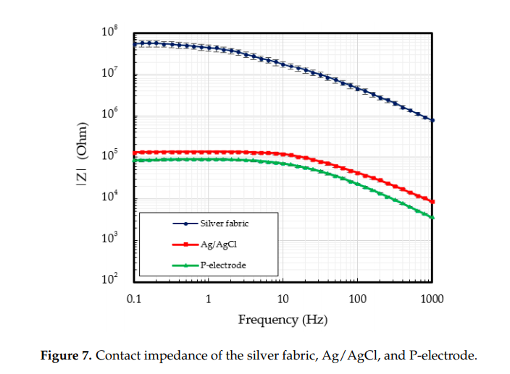
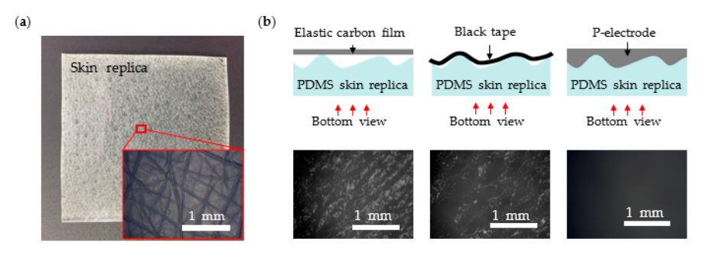
 | ECG – Graphite mixture electrode
Why we choose Graphite mixture electrode
Advantage
Normal ECG use gel(can irritate the human skin)
High conductivity
Reusable
Flexible
Low Contact impedance
.
39.4% 55.3% 100%
ECG Monitoring Garment Using Conductive Carbon Paste for Reduced Motion Artifacts
sddec-19-20
Notes:
Some of the recent approaches use flexible
electrodes, such as textiles and conductive polymers, in order to increase the contact area between the
skin and the electrode by making conformal contact, which reduces the contact impedance
At frequencies under 10 Hz, the contact
impedance of the patch electrode is of 70.0 kW, much lower than the typical 118.7 kW impedance of
a Ag/AgCl electrode. We also demonstrate that the ECG signals measured using the custom-designed
garment and the patch electrodes are very stable even during actions such as walking and running

Slide 31
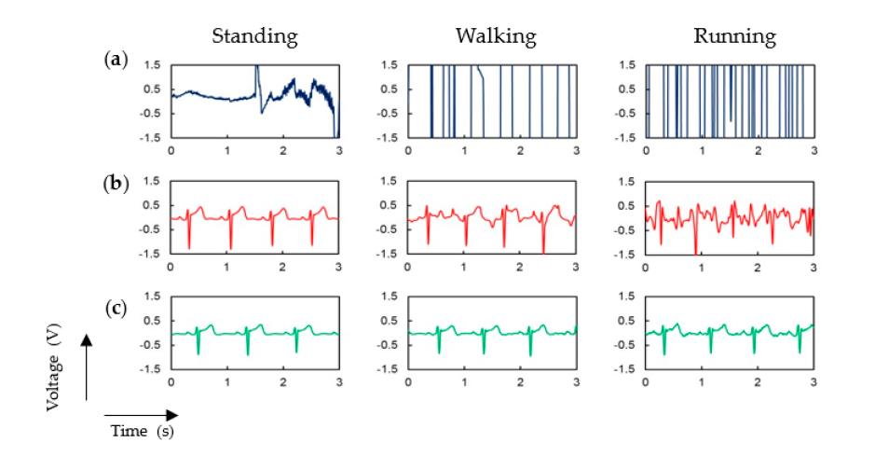
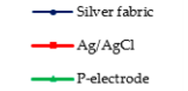
 | ECG – Graphite mixture electrode
Why we choose Graphite mixture electrode
.
ECG Monitoring Garment Using Conductive Carbon Paste for Reduced Motion Artifacts
sddec-19-20
Notes:
Some of the recent approaches use flexible
electrodes, such as textiles and conductive polymers, in order to increase the contact area between the
skin and the electrode by making conformal contact, which reduces the contact impedance
At frequencies under 10 Hz, the contact
impedance of the patch electrode is of 70.0 kW, much lower than the typical 118.7 kW impedance of
a Ag/AgCl electrode. We also demonstrate that the ECG signals measured using the custom-designed
garment and the patch electrodes are very stable even during actions such as walking and running

Slide 32
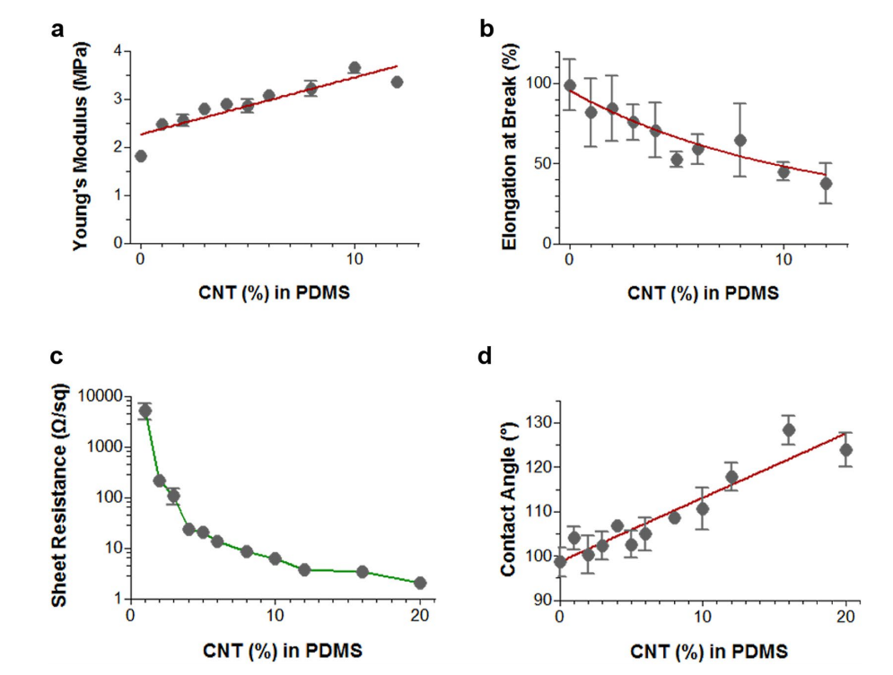
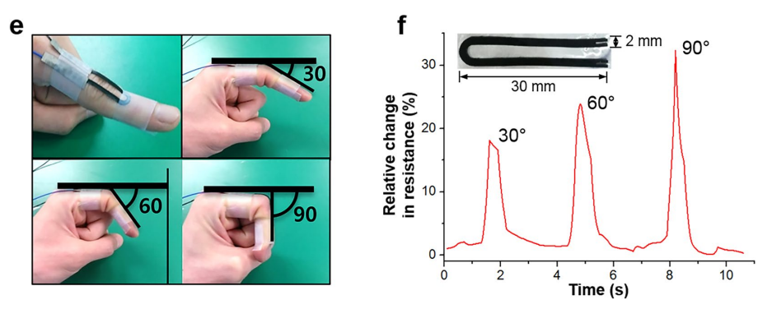
 | Mixture with CNT and PDMS
CNT and PDMS composite
Red line CNT/PDMS electrode / Black line Ag/AgCl electrode.
We can make flexible (use in Mobility sensor )
Simple and cost-efective method of highly conductive and elastic carbon nanotube/ polydimethylsiloxane composite for wearable electronics
sddec-19-20

Slide 33
 | Project Team Tasks
Software Engineers
Electrical Engineers
Justin: Software development and device communication research
Sovann: Software architect and application developer
Omar: DMD printer research and sweat sensor design
Sangwon: DMD printer research and ECG design
SungMin: Mobility sensor design and PDMS development
sddec-19-20

Slide 34
 | Current Status
On schedule:
Software prototype
Mobility sensor
Behind schedule:
Sweat sensor
ECG
Initial plan was to build the 3D printer first

Slide 35
 | Next Semester Plan
Week 1 |  | Week 2 |  | Week 3 |  | Week 4 |  | Week 5 |  | Week 6 |  | Week 7 |  | Week 8 |  | Week 9 |  | Week 10 |  | Week 11 |  | Week 12 |  | Week 13
Finish Software Prototype
Sensor Research |  |  |  | Sweat Sensor Fabrication |  |  |  |  |  |  |  | Sweat Sensor Testing |  |  | Testing With Software
Mobility Sensor Fabrication |  |  |  |  |  |  |  | Mobility Sensor Testing |  |  |  | Testing With Software
Sensor Research |  |  |  | ECG Fabrication |  |  |  |  |  |  |  | ECG Testing |  |  | Testing With Software |  |  |  |  |  |  |  | Final Presenation
 |  |  |  |  |  |  |  |  |  |  |  |  |  |  | Debugging and Optimizing Design and Interface
sddec-19-20

Slide 36
 | Questions?

Slide 37
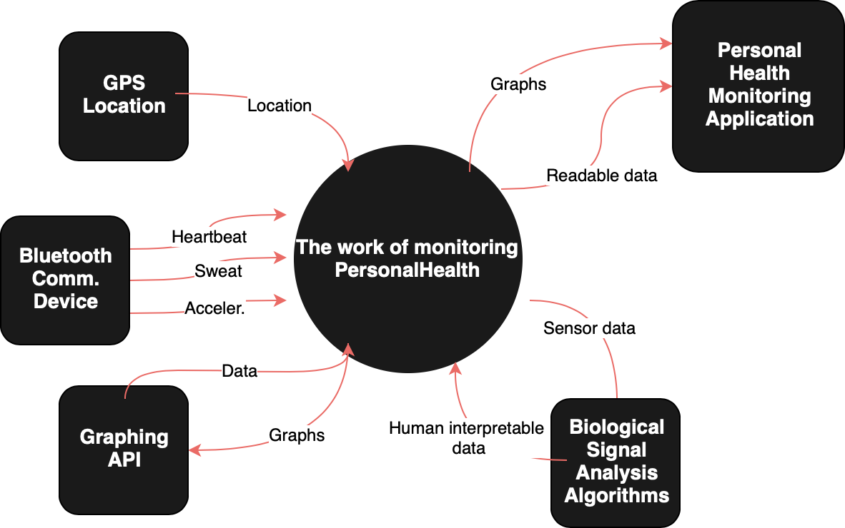
Extra Slides
 | Extra Slides - Context Diagram
sddec-19-20

